Slide 1
Bitcoin Sentimental Analysis
Connor Beard, Mishuk Dutta

Slide 2
Project Refresher
Question:
Can Bitcoin’s price be predicted by the sentimental analysis of Reddit posts in popular Bitcoin/gaming subreddits?
Goal:
Use sentiment scores gathered from the public’s current collective sentiment (Reddit) to create a model that can potentially predict the price or price change in Bitcoin.
Interest:
We believe that little is understood about Bitcoin by many of the people who invest in it. Because of this we feel that people buy and sell mostly based off the current mood of the public. We wanted to dig deeper on this with our own study.

Slide 3
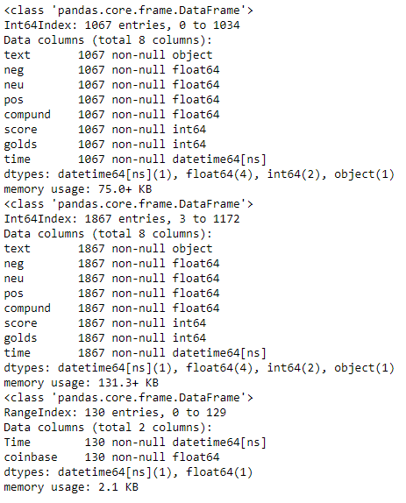
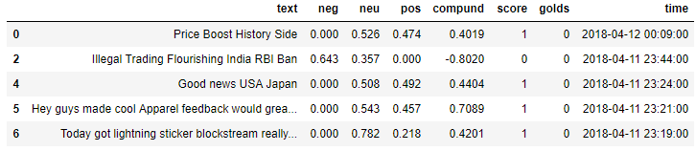
Previous Issues and Solutions
Twitter data was too clustered
Wanted to gather more Reddit data
Deprecated our method in newest version of praw
Picked 5 subreddits
Bitcoin, cryptocurrency, cryptomarkets, gaming, pcmasterrace
Acquired new Bitcoin price hourly data

Slide 4
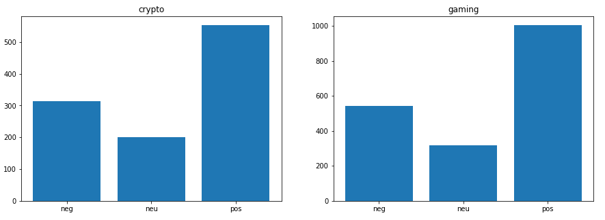
Distribution of Sentiments

Slide 5
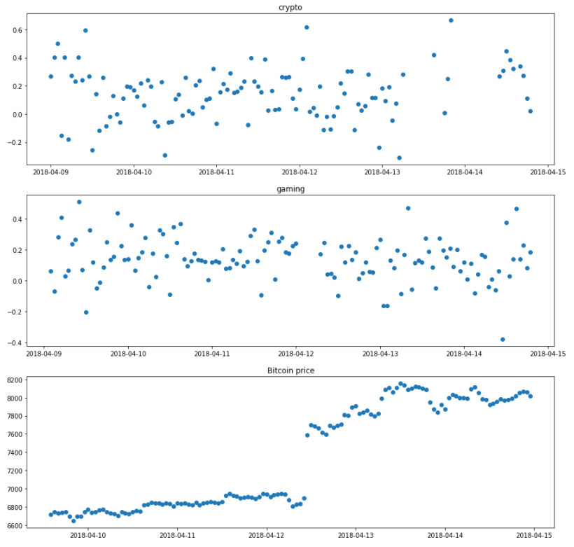


Trends Over Time
(Hourly)

Slide 6
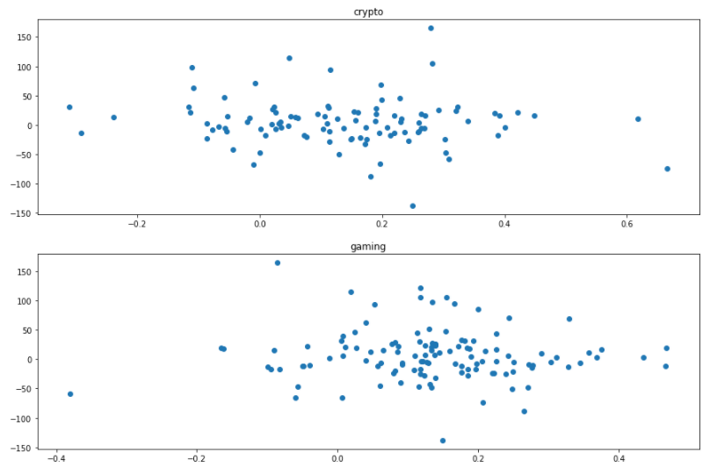
Sentiment vs. Change in Price

Slide 7
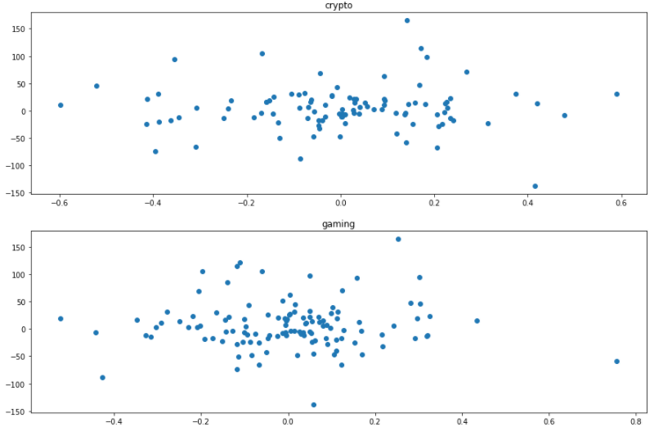
Change in Sentiment vs. Change in Price

Slide 8
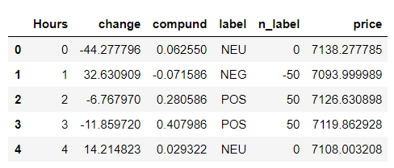
Regression Model:
Linear Regression
Why?
Detecting the Pattern of a dependent Variable using an Independent Variable

Slide 9
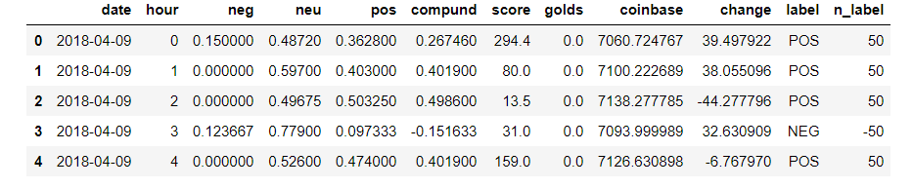
Pre-Processing

Slide 10
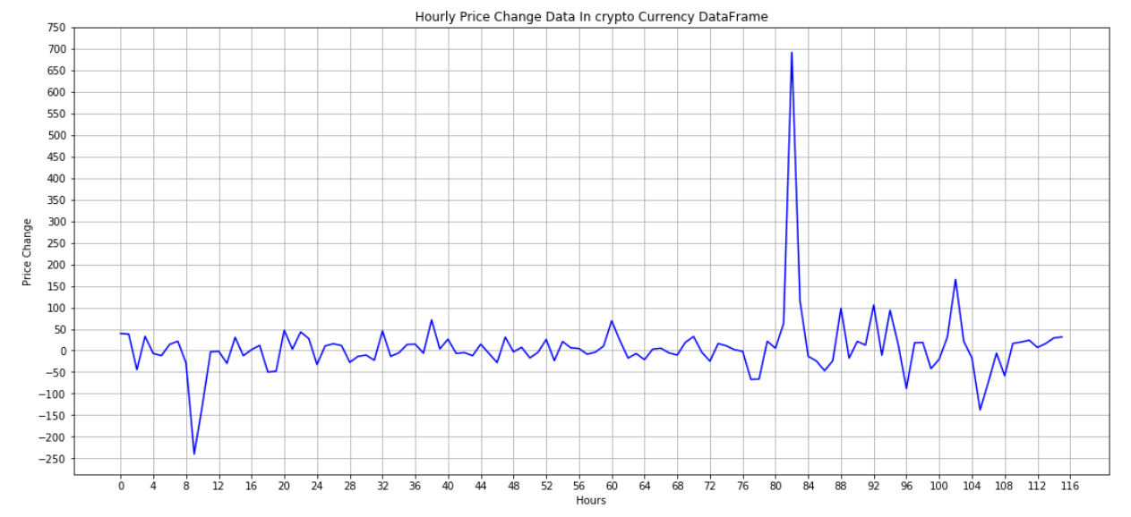
Price Change Graph

Slide 11
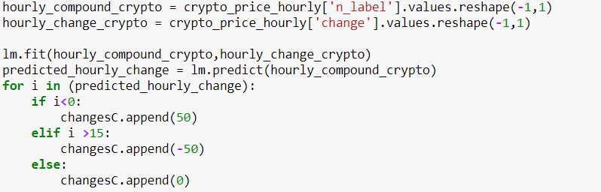

Slide 12
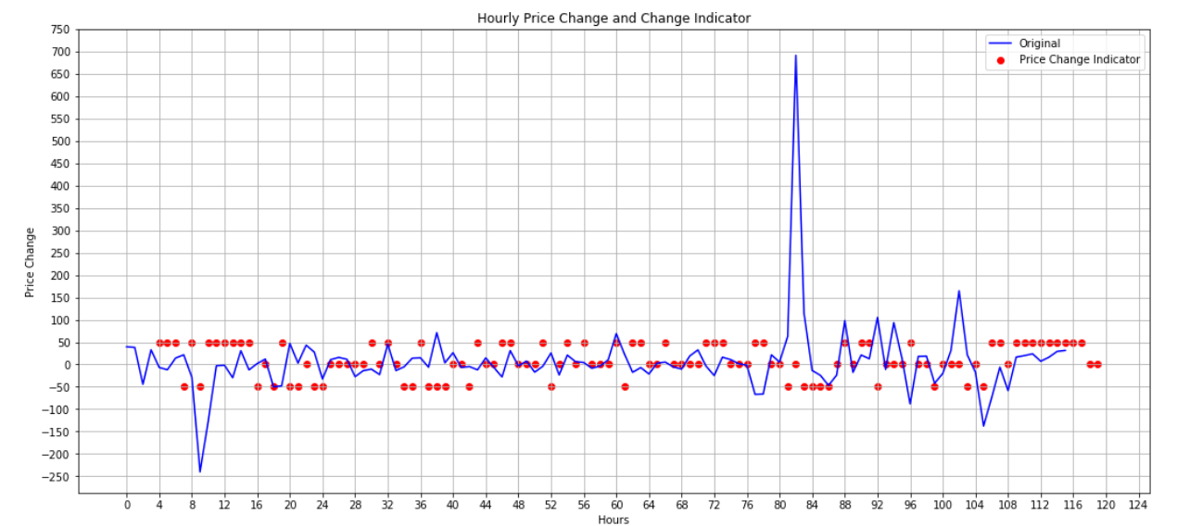
Crypto Regression Fitting

Slide 13
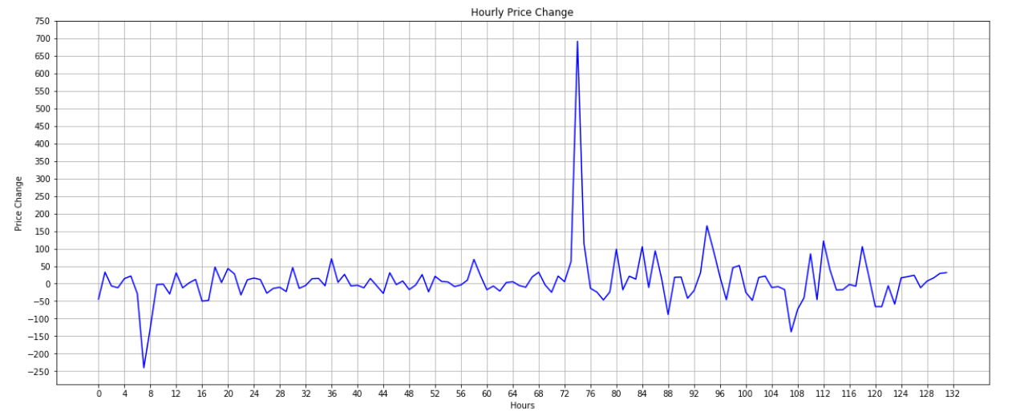
Gaming DataFrames Hourly Price Change

Slide 14
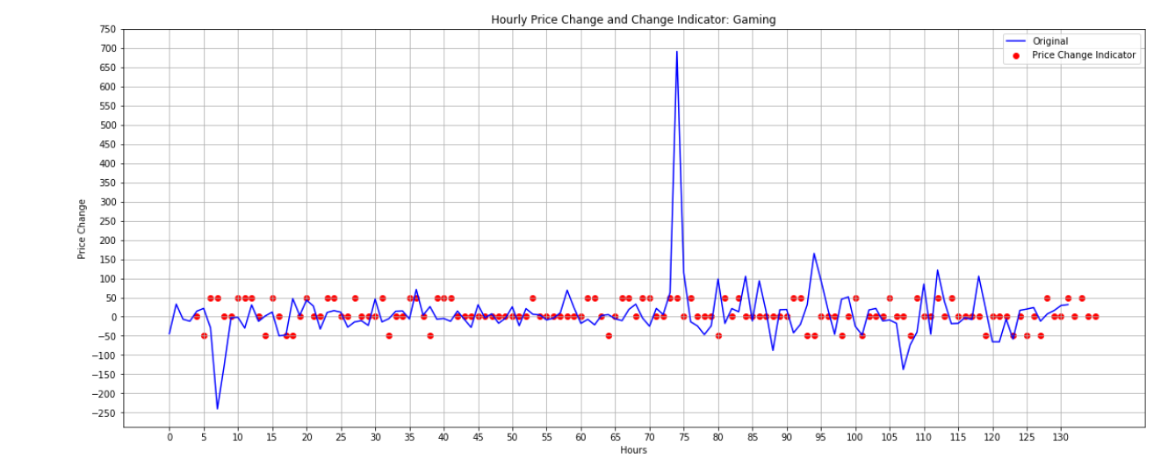
Gaming Data Regression Fitting

Slide 15
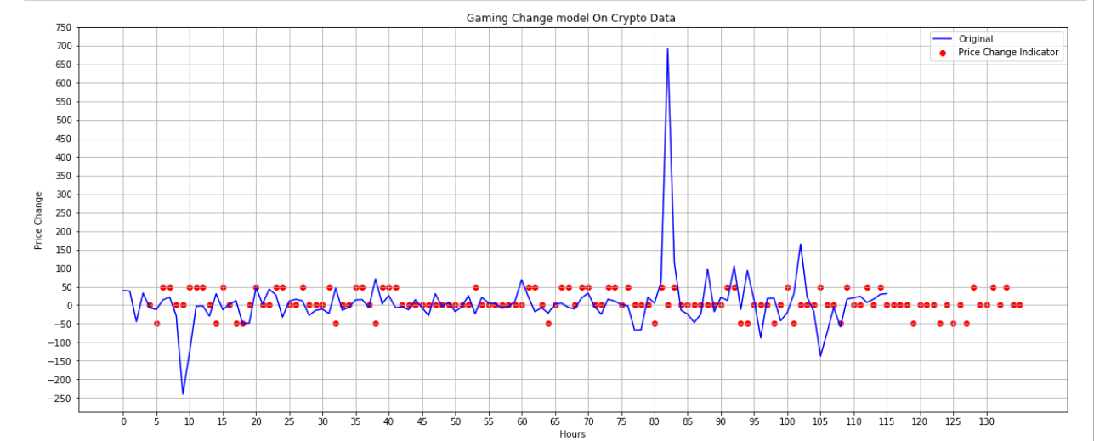
Filling Gaming Model on Crypto

Slide 16
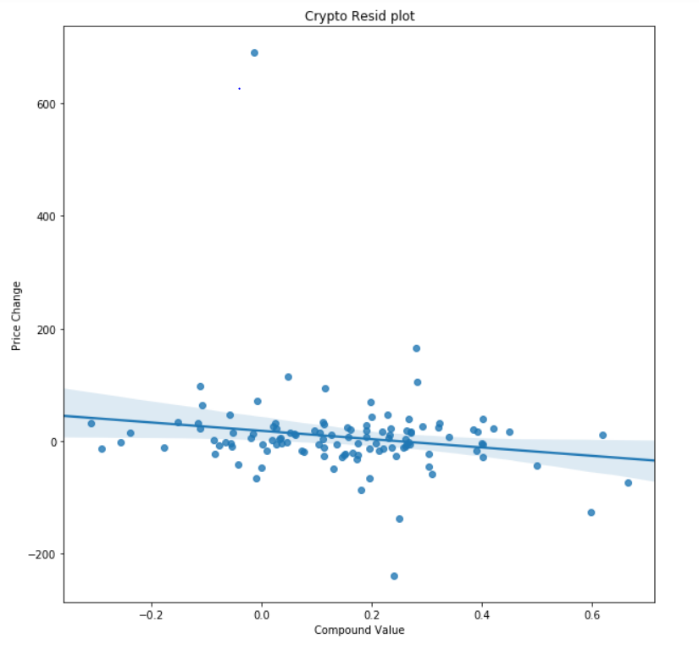
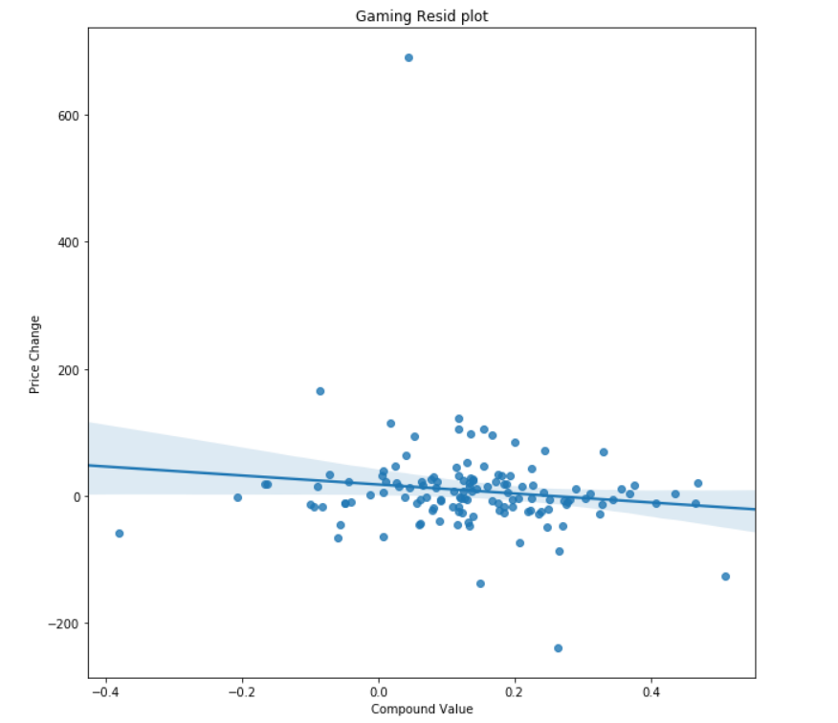
Residual Plots (Accuracy Indicators)

Slide 17
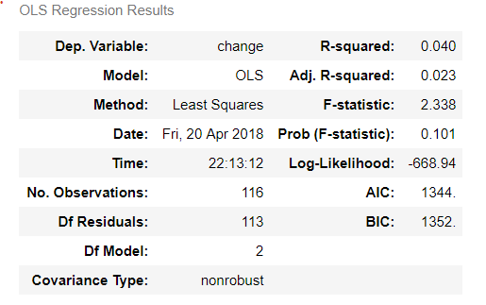
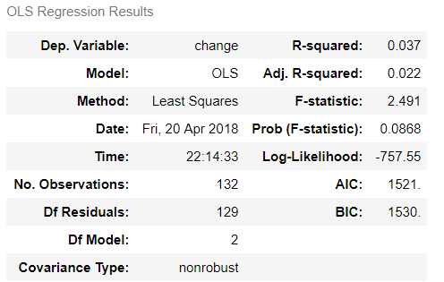
OLS Regressions
Crypto Sub Gaming Sub

Slide 18
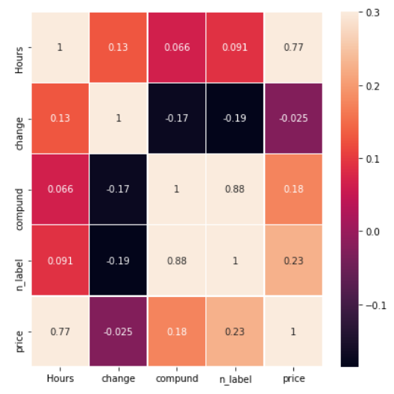
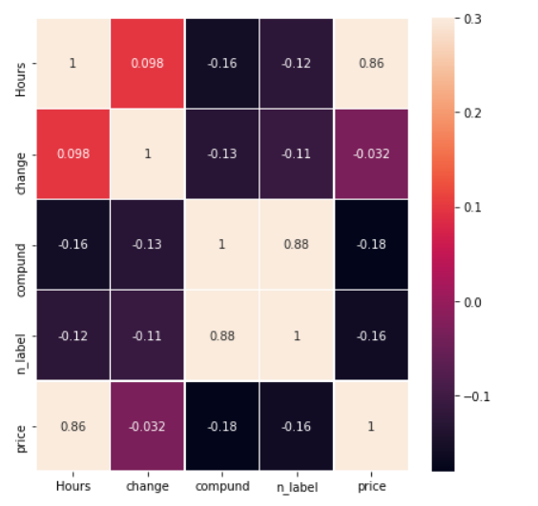
Correlation HeatMap
Crypto Gaming

Slide 19
Conclusion
Low R-Squared
Too low of an F statistic
With our data we feel that we cannot conclude that sentiment is a good predictor for Bitcoin price
We do believe though that with more data over a long period of time, a good correlation would exist
If we were to run the experiment again we would want to gather at least a couple months worth of data

